Slide 1

✓ PROJECT COMPLETED
Smart Library
Book Locator System
Web-Based Book Search & Location System — Fully Developed & Deployed
✓ Search Functional
✓ Exact Location Live
✓ Database Connected
Academic Final Project | College Library Management

Slide 2





Project Overview
What Was Built
Project At a Glance
Fully working website for book search
10+
Web Pages / Screens
Search by book title or author name
2
Core Modules
Exact rack, column, row & position output
database connected(LocalStorage)
100%
Features Completed
Clean, responsive web interface
1
Integrated Database

Slide 3






Pages & Modules Built
Home Page
Search Results
Book Location Page
Search bar, welcome message, quick access,Login
Lists matching books with details & location
Exact rack → column → row → position display
Book Details Page
Admin Panel
About / Help Page
Full info: title, author, ISBN, availability
Add, edit, delete books and location records
Usage guide and library contact information

Slide 4
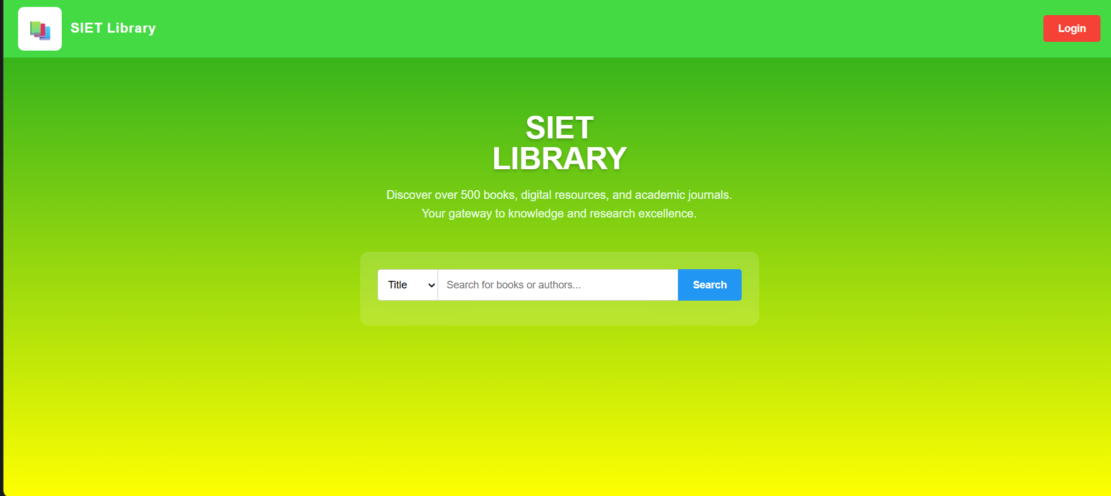
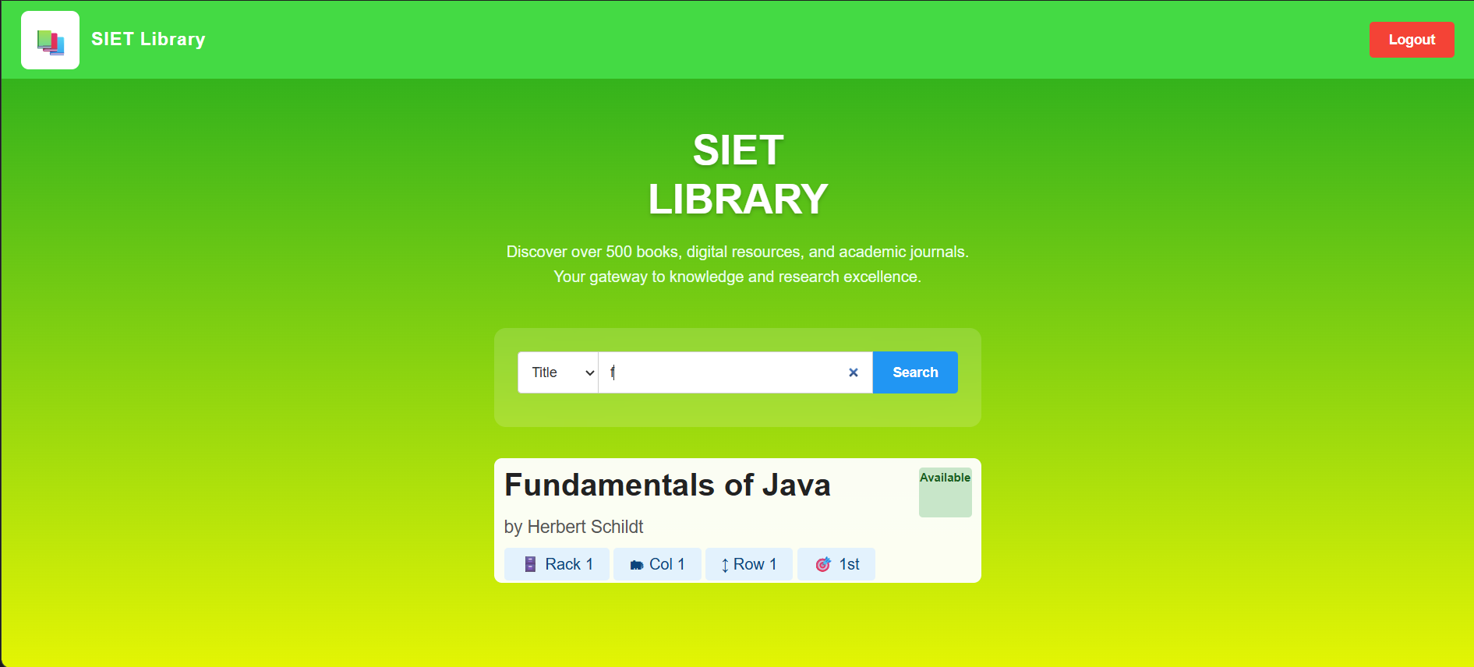

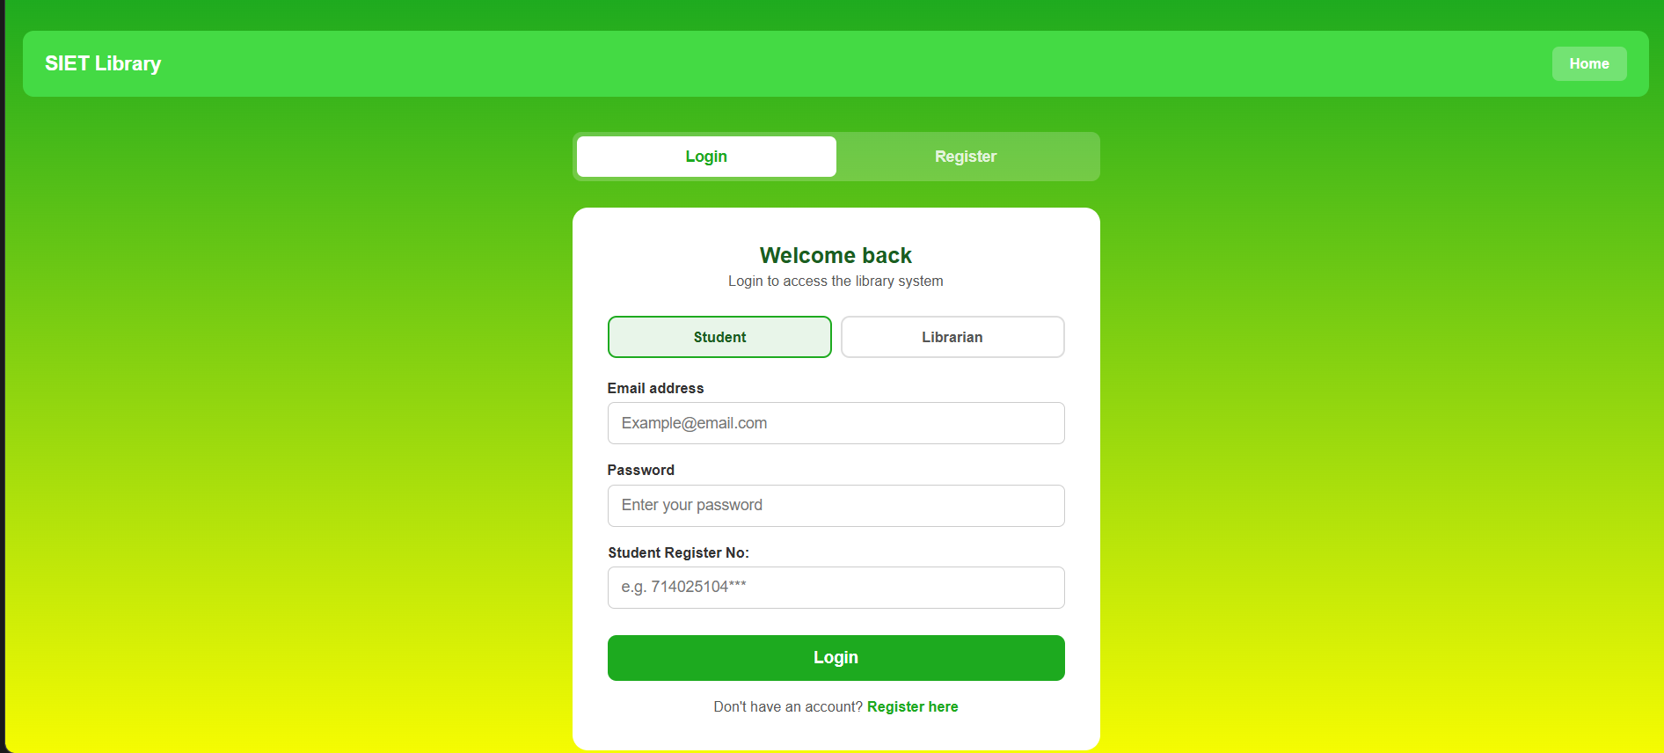
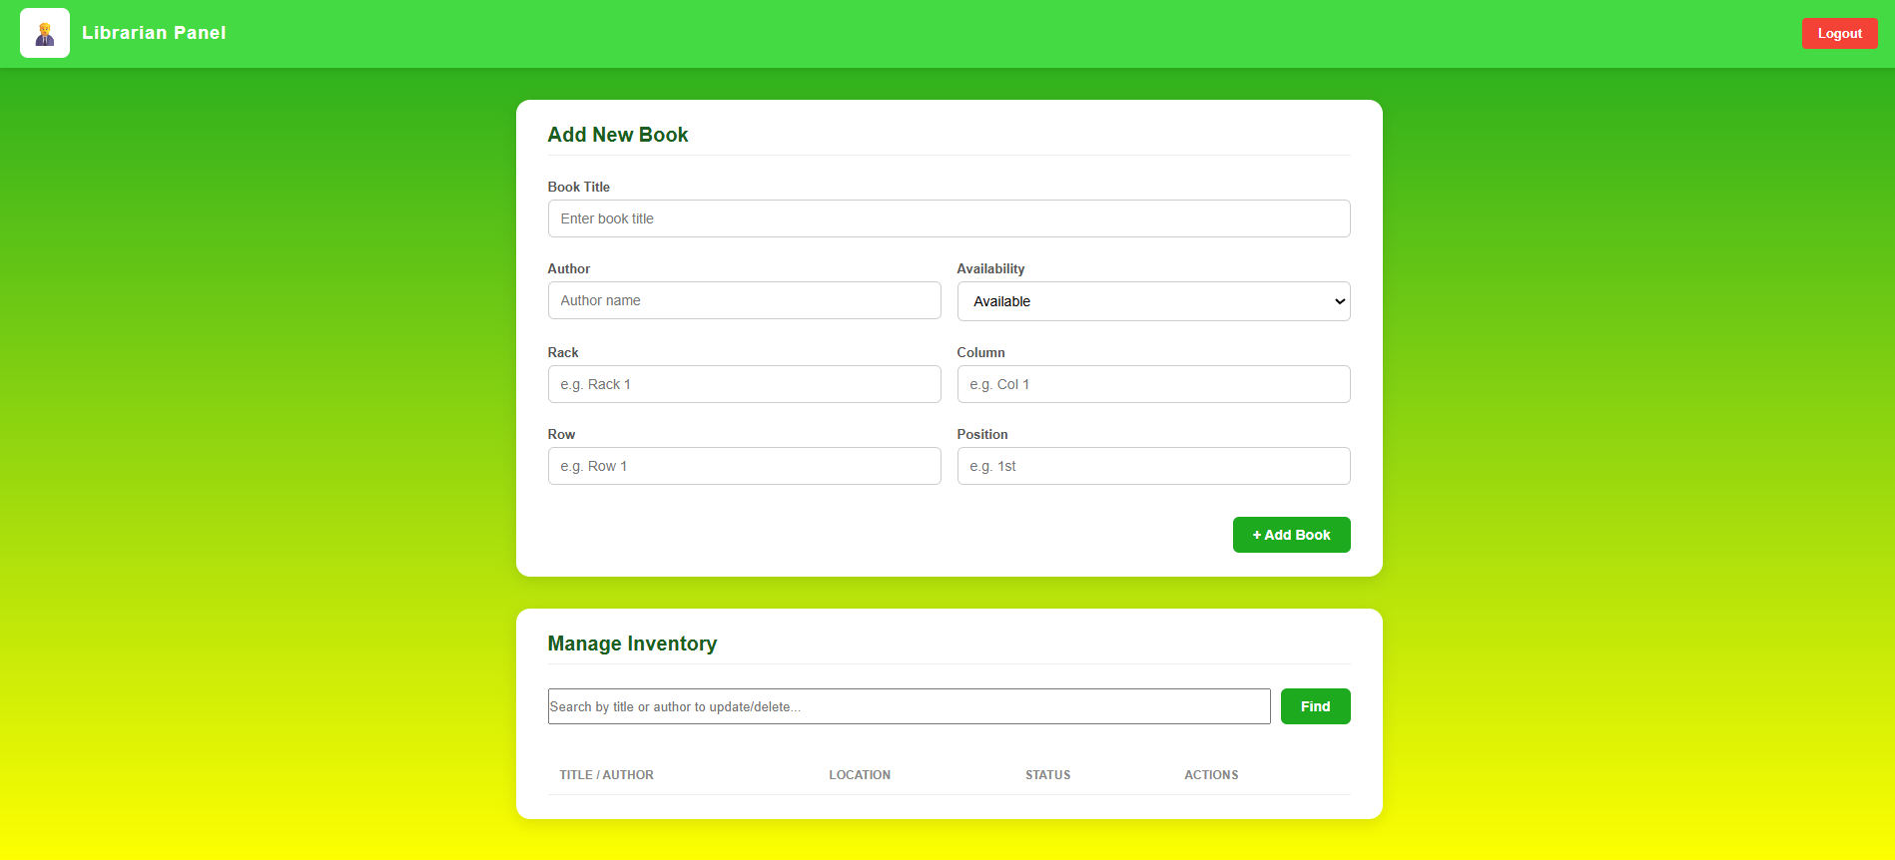
Website Screenshots
Home Page – Search Bar
Search Results Page
Login page
Admin Panel
[Replace with your screenshot]
[Replace with your screenshot]

Slide 5



Technical Implementation
Frontend
Backend
Database
HTML5 — Structure & Layout
PHP / Node.js — Server Logic
MySQL / PostgreSQL
CSS3 — Styling & Animations
Form Handling & Validation
Books Table — title, author, ISBN
JavaScript — Dynamic Behaviour
Search Query Processing
Location Table — rack, col, row, pos
Responsive Design — Mobile Friendly
Session & Error Management
Admin CRUD Operations

Slide 6


How the Search Works – Technical Flow
1. User Input
2. Backend Query
3. DB Lookup
4. Result Display
<input type="text"
name="search">
SELECT * FROM books
WHERE title LIKE
"%keyword%"
JOIN book_locations
ON books.id =
locations.book_id
Rack: Second
Column: Second
Row: Third
Pos: 4th

Slide 7










Features – Completed
Search by book title
DONE
Search by author name
DONE
Exact shelf location display
DONE
Book availability status
DONE
Admin: Add / Edit / Delete books
DONE
Database fully integrated
DONE
UPCOMING
Responsive web interface
DONE
Input validation & error handling
DONE
UPCOMING
Mobile App (Future)
UPCOMING
RFID / Barcode scanning (Future)
UPCOMING

Slide 8
Testing & Results
Test Case | Result | Status
Search by exact book title | Correct book & location returned | PASS
Search by partial title keyword | All matching books listed | PASS
Search by author name | All books by author displayed | PASS
Book not in database | 'Not found' message shown | PASS
Admin: Add new book | Book saved and searchable | PASS
Admin: Edit book location | Updated location shown instantly | PASS
Admin: Delete a book | Book removed from search results | PASS
Mobile / small screen view | Layout adjusts correctly | fail

Slide 9



Future Enhancements
Phase 2
Mobile App
Android/iOS app for students to search on the go
Phase 2
RFID / Barcode
Real-time tracking of books using hardware scanners
Phase 3
Student Login
Personal account to save searches and reserve books
Phase 3
Visual Shelf Map
Interactive library map showing exact shelf position
Phase 4
AI Recommendations
Suggest related books based on search history

Slide 10
Project
Successfully Completed!
100% COMPLETED
✓
Fully functional web-based book locator system built from scratch.
✓
Search, location display, admin panel and database all working.
✓
Ready for real-world deployment in any college library.
Thank You
Smart Library Book Locator System

